Slide 1

CHS Physics Day at Six Flags
Friday, April 26th, 2019

Slide 2
Today’s Overview
Schedule
Lab Expectations
Be Prepared
General Information and Other Details
Working from CHS
Q & A
New Lab Information (Force Factor Meters)

Slide 3
Friday’s Schedule
Itinerary / *Check In
* 7:30-40 am Greyhound Entrance at Clayton High School
* 7:45 am Bus roll call
7:45am Buses leave Clayton High School
9:00 am Park Opens
* On park entry See Chaperone at Mr. Freeze
* 12:00 noon Check-in World’s Fair Picnic Area
(Picnic Combo available from 11:00 am to 1:00 pm at World’s Fair Picnic Area)
12:00 noon Bag Lunches pm at World’s Fair Picnic Area
1:50 Athlete(s) meet at Fountain inside Park Entrance BusPickup
*4:15pm At Fountain inside Park Entrance
*4:30pm All ride packets turned in, equipment turned in. On bus, quiet and ready for roll call. Buses leave Six Flags.
5:30pm Buses arrive at Clayton High School

Slide 4
Buses
 | Bus 1 | Bus 2 | Bus 3 | Bus 4 | Bus 5 | Bus 6
Chap | Adams Turner | Ostapwicz Young Schneider | Swift Boyd | Schwent Cowin | Schuster Danskey | Beauchamp Ferris
Classes | Adams 5,7 | Laux 1,5,7 | DLP 1,7 | DLP 3,5 | Schuster 1,3 | Adams 3 Laux 3 Schus 7

Slide 5
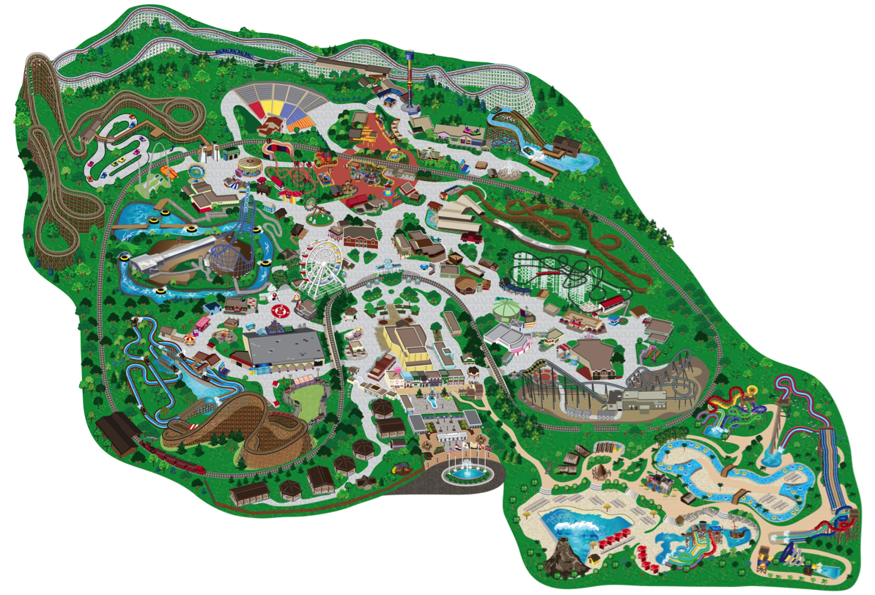
Carousel
Superman
Highland Fling
Rush Street Flyer
Screamin’ Eagle
Waterstreet Cab Co.
Sky Screamer
Ninja
Joker
Xcalibur
Batman
Mr. Freeze
Fountain
World’s Fair Picnic Area
Main Entrance

Slide 6
Lab Expectations
Where to find lab packets?
claytonphysics.net
What is expected?
Bring your own ride packets and cell phone
Complete, correct, and by 4:15pm
Highly encouraged to get lab work done early in the day
Variations for different courses

Slide 7
FoP: ANY 3 FP: 1/column HFP 1 column A + 2?
Column A | Column B | Column C
Mr. Freeze | Sky Screamer | Superman
Batman | Joker | Carousel
Ninja | Carousel
Screaming Eagle
Superman

Slide 8
Be Prepared
Print out any ride activities put your name them
Read (carefully) the Suggestions for Making Measurements document
Read (carefully) the Student Introduction and Rider Responsibilities document
Read (carefully) each of your packets before Friday.
Bring a picture ID so that you can check out a data collection vest
Dress appropriately for the weather (53-72 F)
Arrive with pen/pencil, all packets with your name on them, lunch or lunch money if needed
---No highlighter/dry erase

Slide 9
Be Prepared
Be on time 7:30 am at Greyhound Entrance
As you get off the bus at the park, keep track of ticket(s) and equipment bag, packet
Know when and where check-ins are. Plan to be there on time.
Use your map. Plan what rides activities you will do 1st, 2nd, ....
Turn in your labs and equipment bag as you get on the bus at 4:30pm.

Slide 10
General Information
Contact numbers of the physics teachers, phone vs. text
Please remember that you are a representative of your school at this event. Please act accordingly. The future of Physics Day at Six Flags for future CHS freshman physics students is in your hands.

Slide 11
Working from CHS
Schedule
Be Prepared
1st -8th LC
        There will be a 4 period break for lunch.
lab Packets will be provided
Bring other work
Bring a book to read if you finish early
Other Opportunities: classes, extra help

Slide 12
Q & A

Slide 13
New Lab Information
First drop
Sensation of weight
Initial oscillation, Maximum oscillation
Weightless zones
Frame of reference
Tangential speed, Angular speed
Accelerometer and Force Factors: head-to-toe, front-to-back
  Mr. de la Paz

Slide 14
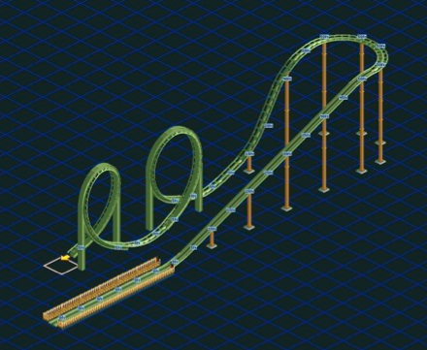
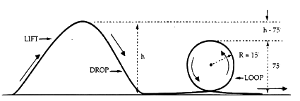
First Drop

Slide 15


Sensation of Weight (Apparent Weight)
Normal force vs Gravitational Force
F_{NPS}
F_{GPE}
F_{GPE}

Slide 16
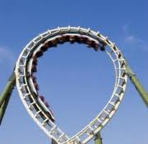
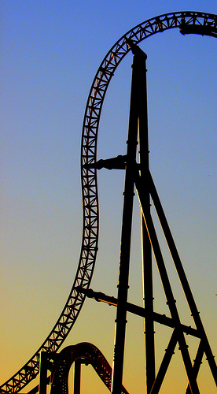
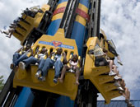
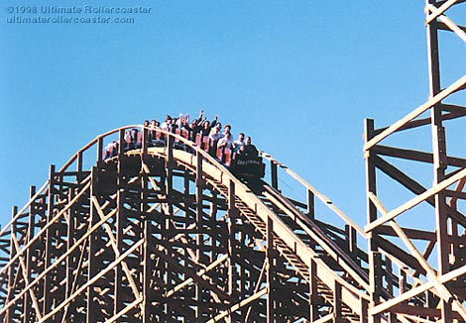
Weightless zone, well there’s still weight but something is missing. . .
In order to feel weight there must be a "reaction" force.
Draw the force
diagram for each
situation, what force
is missing from each? What force is present in each?
F_{GPE}

Slide 17
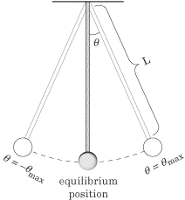
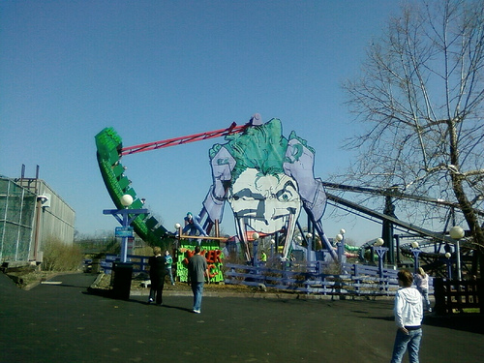
Initial oscillation, Maximum oscillation
Period (T): Time passing for one revolution is called period. The unit of period is second.
Frequency (f): Number of revolutions per one second. The unit of frequency is 1/second.

Slide 18
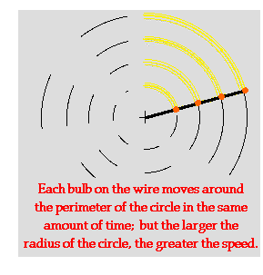
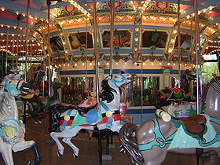
Tangential speed & Angular speed
Tangential speed = distance traveled in a given time interval
Angular speed = number of revolutions in a given time interval

Slide 19

Frame of reference
It’s all how you see it (or measure it), let’s watch:

Slide 20
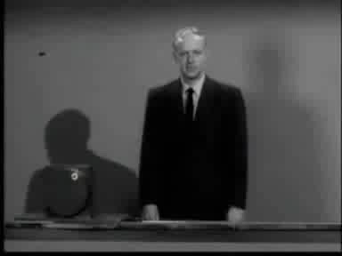
Frames of Reference (Part 2)

Slide 21

Frames of Reference (Part 3)

Slide 22

Frames of Reference (Part 4)

